Slide 1


Topic Search: An Application of Chat-GPT 4 in the UK Parliament
Michael Webb, PhD
Université Grenoble Alpes; POLINEQUAL

Slide 2
POLINEQUAL
Inequality is an increasingly salient issue, but its framing varies. Debates arise around deservingness and government intervention.
We focus on three key cases: Great Britain, France, and Sweden
The broader project asks a few questions:
  How does the framing of inequality vary between and within countries?
    Between sub-national regions?
    Between mediums?
    Between political parties and the general population?
    Between political parties?
  What is the political/policy significance of this variation?

Slide 3
This Project
Assess discussions of inequality in Westminster Hall Debates.
Using Chat-GPT 4 to identify discussions of inequality and to characterize the content of those discussions.
Beginning to answer a few questions:
  How frequently is inequality mentioned?
  What sort of inequality is discussed?
  Is there variation in the discussion of inequality across parties?
  Is there variation across MPs representing different kinds of constituencies?

Slide 4
Westminster Hall Debates
In the UK parliament, the Westminster Hall debates serve as a platform for agenda setting.
Members of parliament bring issues they deem important up for discussion.
In each debate all major parties are required to participate.
In this way hundreds of topics are given (ideologically) holistic consideration each year, with a primary emphasis on the framing of the topic (not the specifics of legislation)

Slide 5
Prompting Topic Search with Chat GPT
Rather than seeking to model latent topics present in the text, use Chat GPT to identify instances where a topic of interest is being discussed.
In our case the focus is on inequality.
Feeding the model paragraphs from speeches, ask it to assess whether some form of inequality is explicitly discussed.
As a second step, assess what sort of inequality is discussed in each case (I present 18 possible sub-types for it to consider).

Slide 6
Dimensions of Inequality
Group Based Inequalities – Focused on the disparities between groups (resource agnostic).
  Gender
  Race/Ethnicity
  Age
Resource Based Inequalities – Focused on disparities pertaining to a specific resource (group agnostic)
  Income
  Education
  Healthcare

Slide 7
  #### base analysis prompt
  You are an expert analyst studying paragraphs of speeches. For each paragraph given, analyze the content carefully and then provide specific answers to the following questions. Responses should be in the format: "{paragraph number from text}|1:{answer 1}|2:{answer 2}|3:{answer 3}|4:{answer 4}|5:{answer 5}|6:{answer 6}|7:{answer 7}|8:{answer 8}". Do not include any extra text in your response and answer all questions.
  Does the paragraph...
  Discuss economic issues? (Yes or No)
  Focus on the poor? (Yes or No)
  Focus on the wealthy? (Yes or No)
  Call for government action? (Yes or No)
  Discuss Taxation? (Yes or No)
  Discuss government policies? (Yes or No)
  Discuss inequality specifically? (Yes or No)
  What are two distinct Eurovoc descriptors for this paragraph?

Slide 8
You are an expert analyst examining how British members of parliament discuss inequality. Each paragraph you will be shown has already been identified as relating to inequality. Your role is to assess what sort of inequality is being discussed. Below is a list of types of inequality, consider it carefully. Afterwards read the text provided below and determine which (if any) of the types of inequality listed are being referenced by the text.For each paragraph given, analyze the content carefully and then provide specific answers to the following questions.
Your response must adhere to the following format: paragraph number (from text)|1:{answer 1}|2:{answer 2}|3:{answer 3}|4:{answer 4}|5:{answer 5}|6:{answer 6}|7:{answer 7}|8:{answer 8}|9:{answer 9}|10:{answer 10}|11:{answer 11}|12:{answer 12}|13:{answer 13}|14:{answer 14}|15:{answer 15}|16:{answer 16}|17:{answer 17}|18:{answer 18}
Do not include any text other than the formatted response. You must provide a set of responses for every paragraph.
Does this text involve...
1. ...income inequality?
2. ...wealth inequality?
3. ...employment inequality?
4. ...educational inequality?
5. ...cultural/artistic inequality?
6. ...health inequality?
7. ...justice/legal system inequality?
8. ...gender inequality?
9. ...racial or ethnic inequality?
10. ...age-based inequality?
11. ...socioeconomic inequality?
12. ...sexual-orientation inequality?
13. ...disability-based inequality?
14. ...religious inequality?
15. ...immigration status inequality?
16. ...property ownership inequality?
17. ...policy outcome inequality?
18. ...regional/place-based inequalities?

Slide 9
Data
Complete set of Westminster Hall debates from January 1st 2020 to December 31st 2020.
238 Debates, 508 Participants, 25,250 Paragraphs, 2.25 Million Words
2,084 paragraphs mentioning inequality
Key questions addressed today:
  What sort of inequality is being discussed?
  How does the conceptualization of inequality vary between MPs?

Slide 10
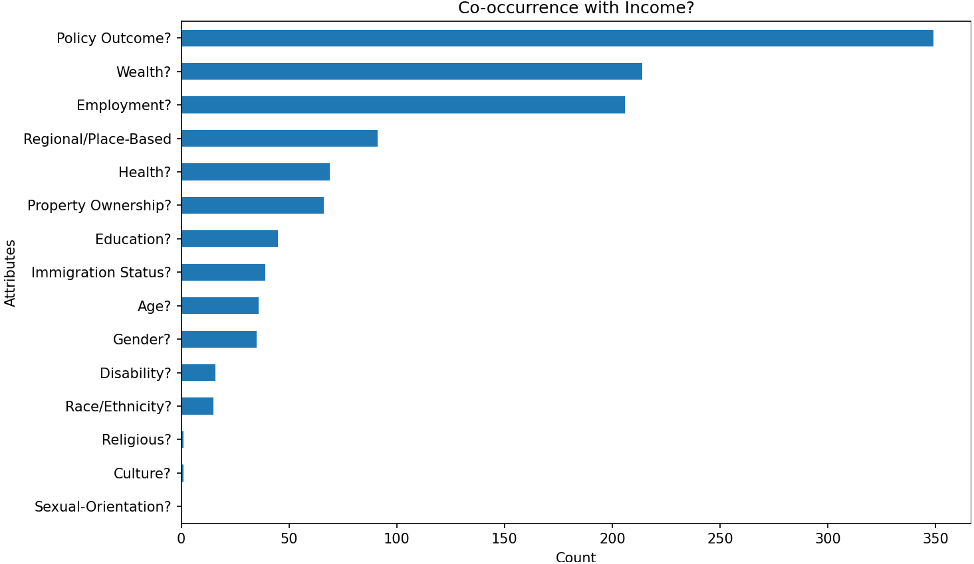

Slide 11
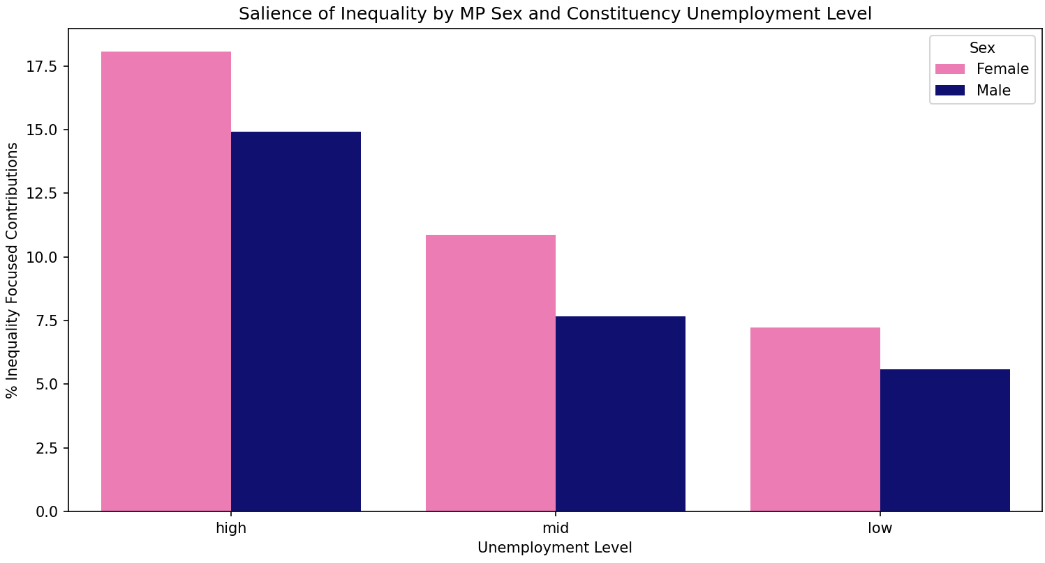

Slide 12
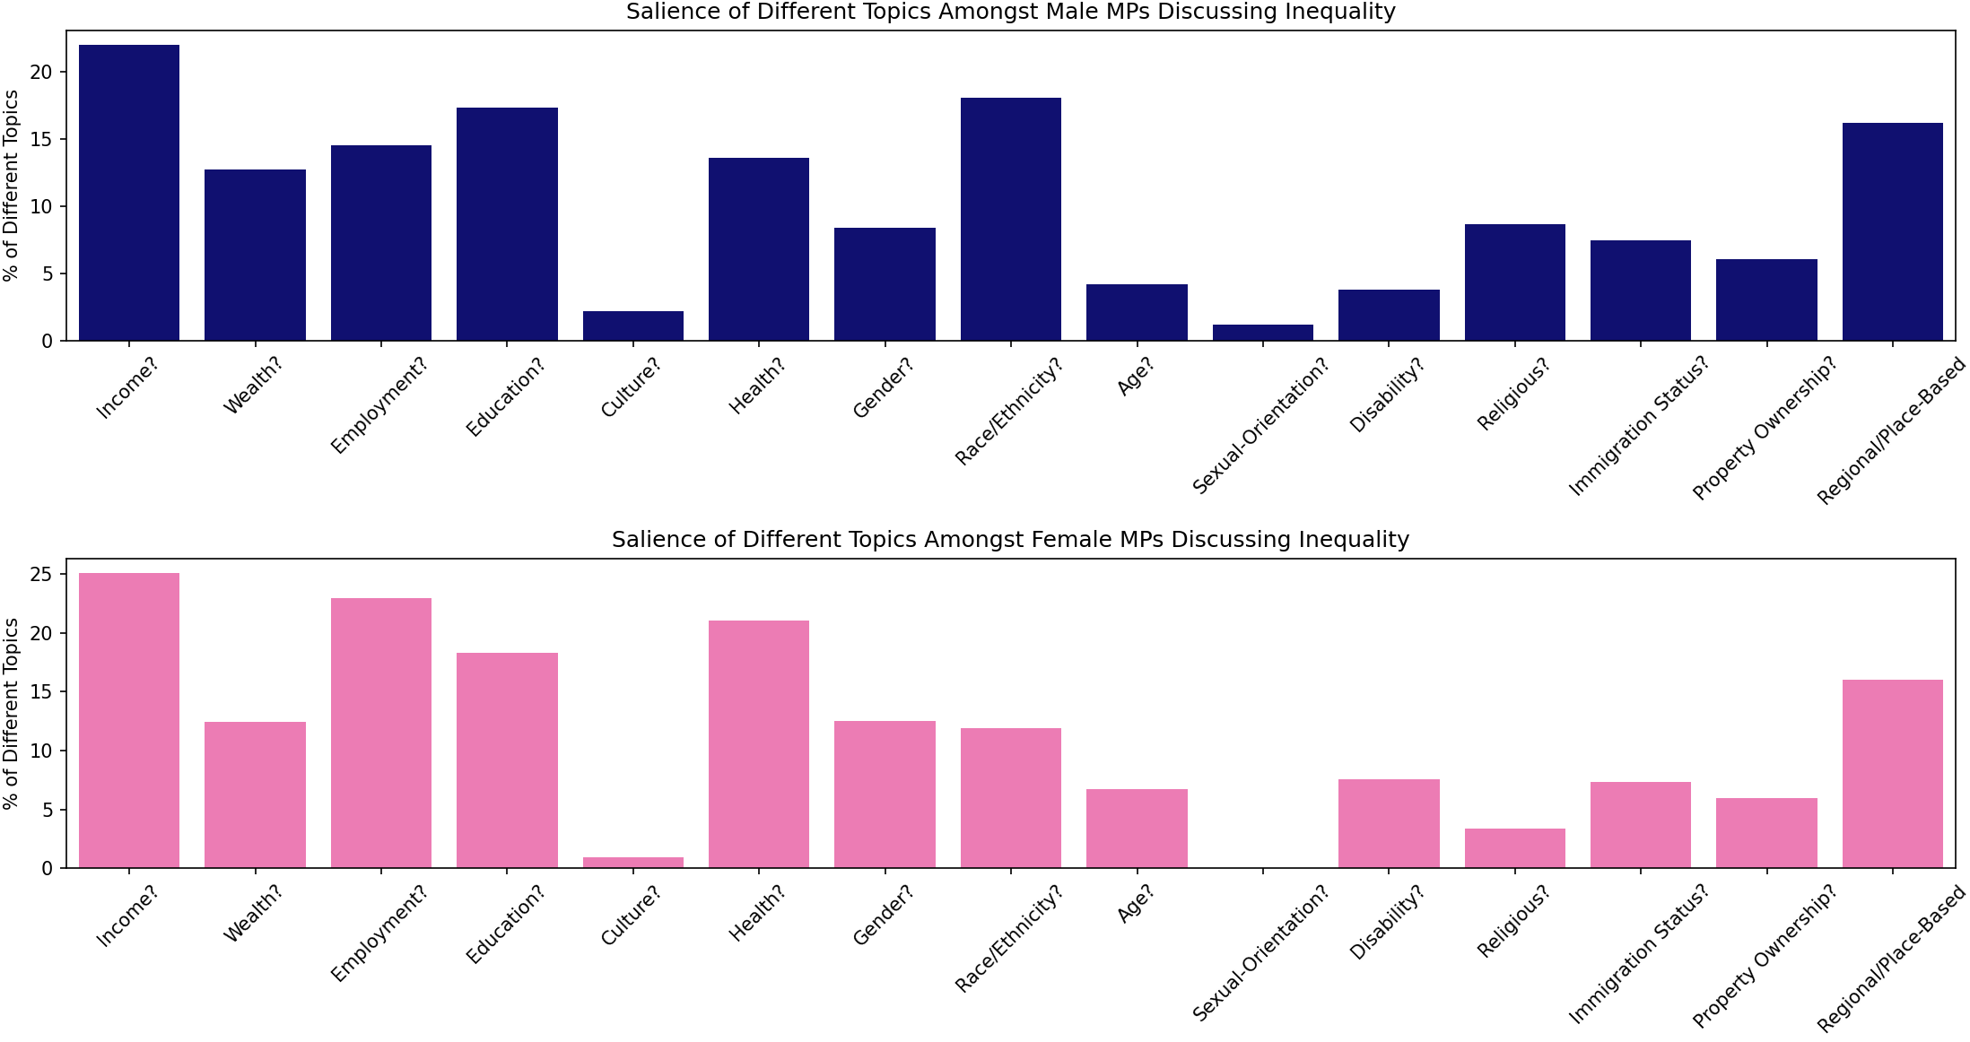

Slide 13
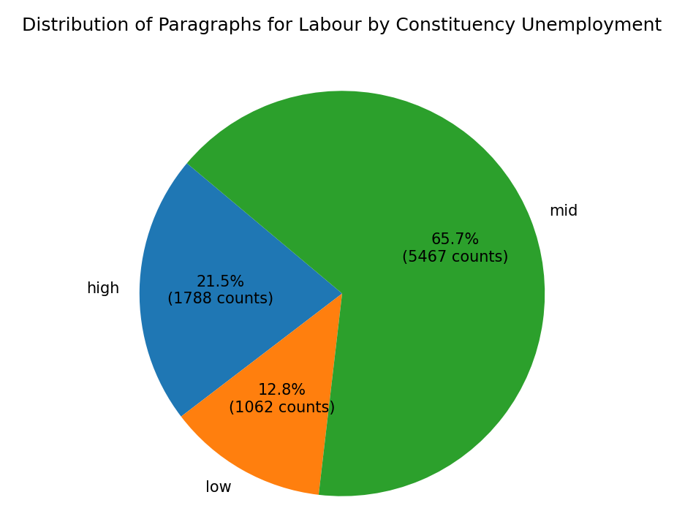
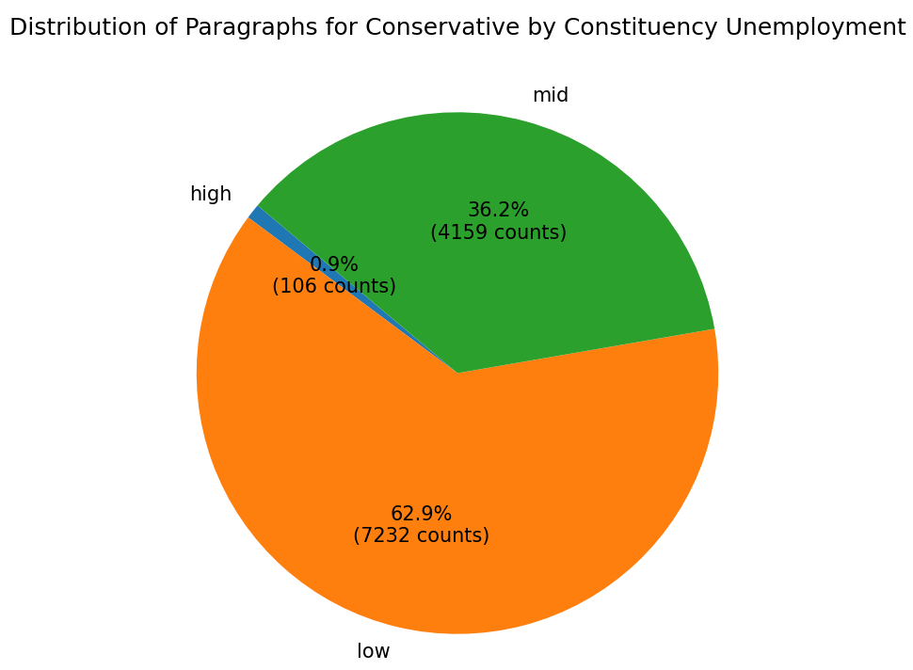
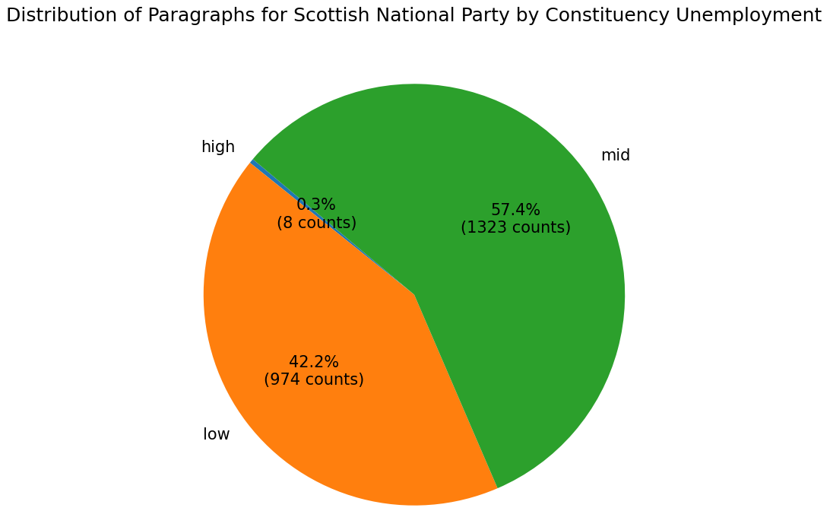

Slide 14
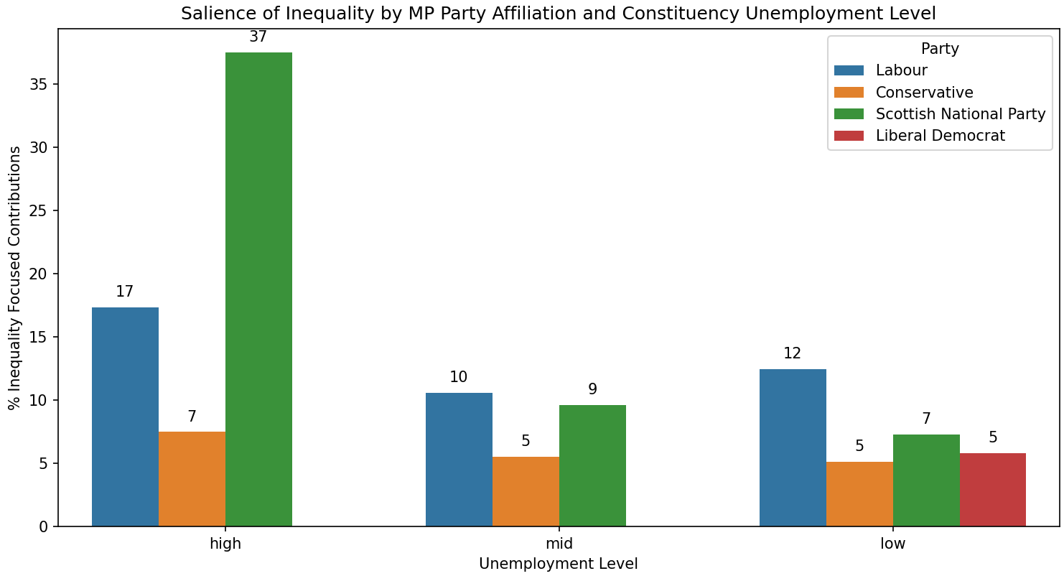

Slide 15
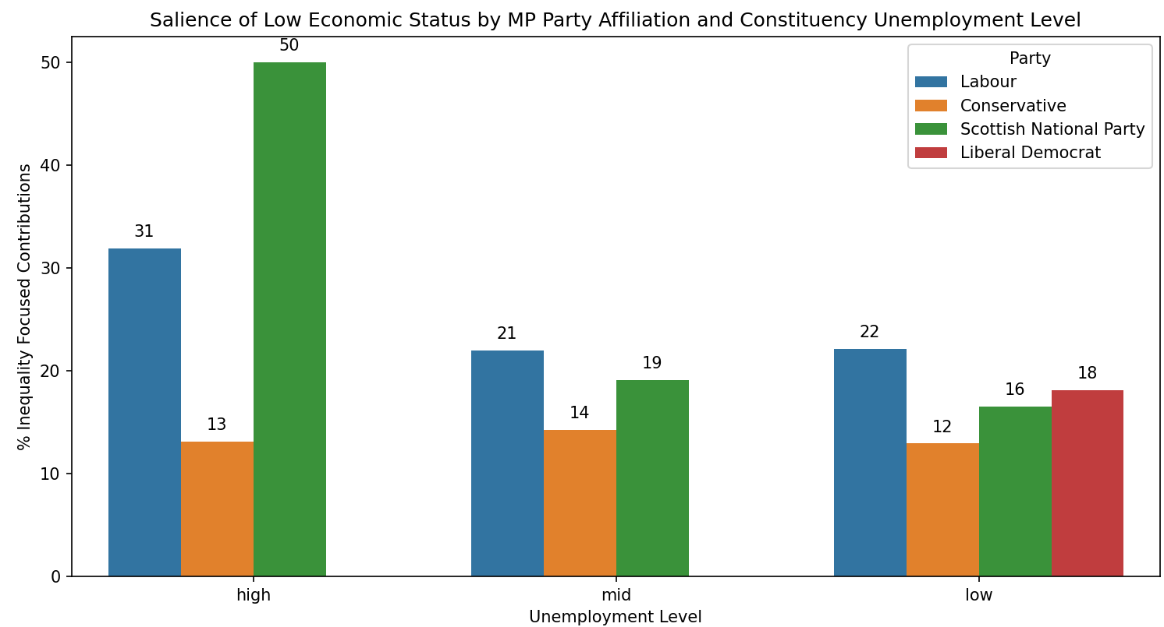

Slide 16
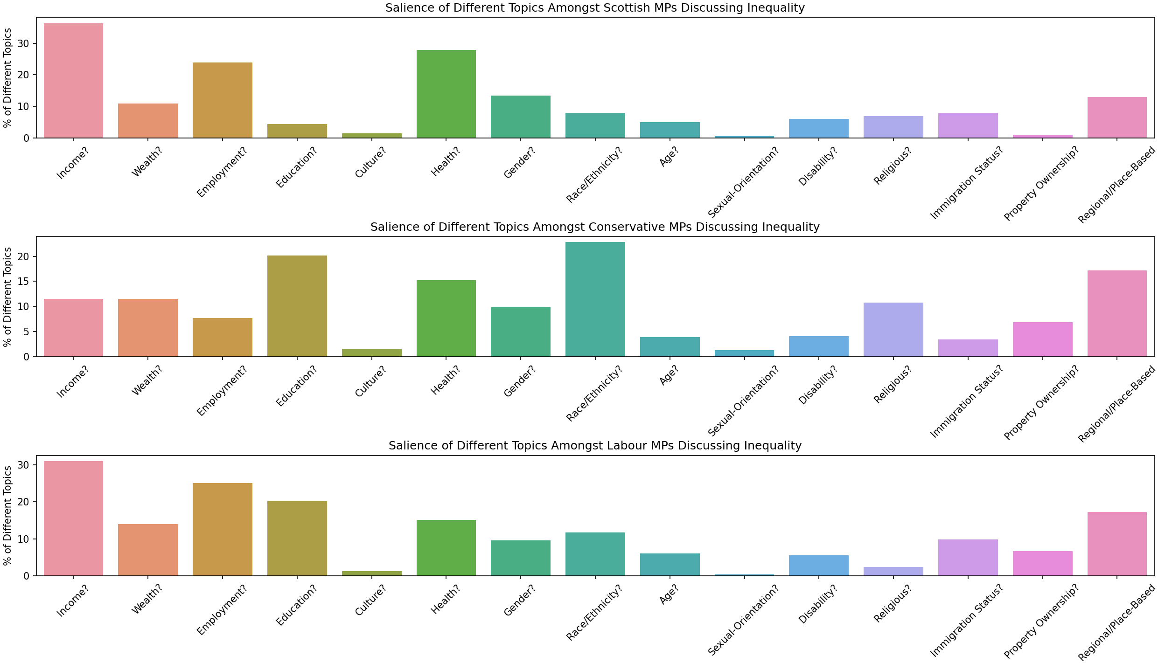

Slide 17
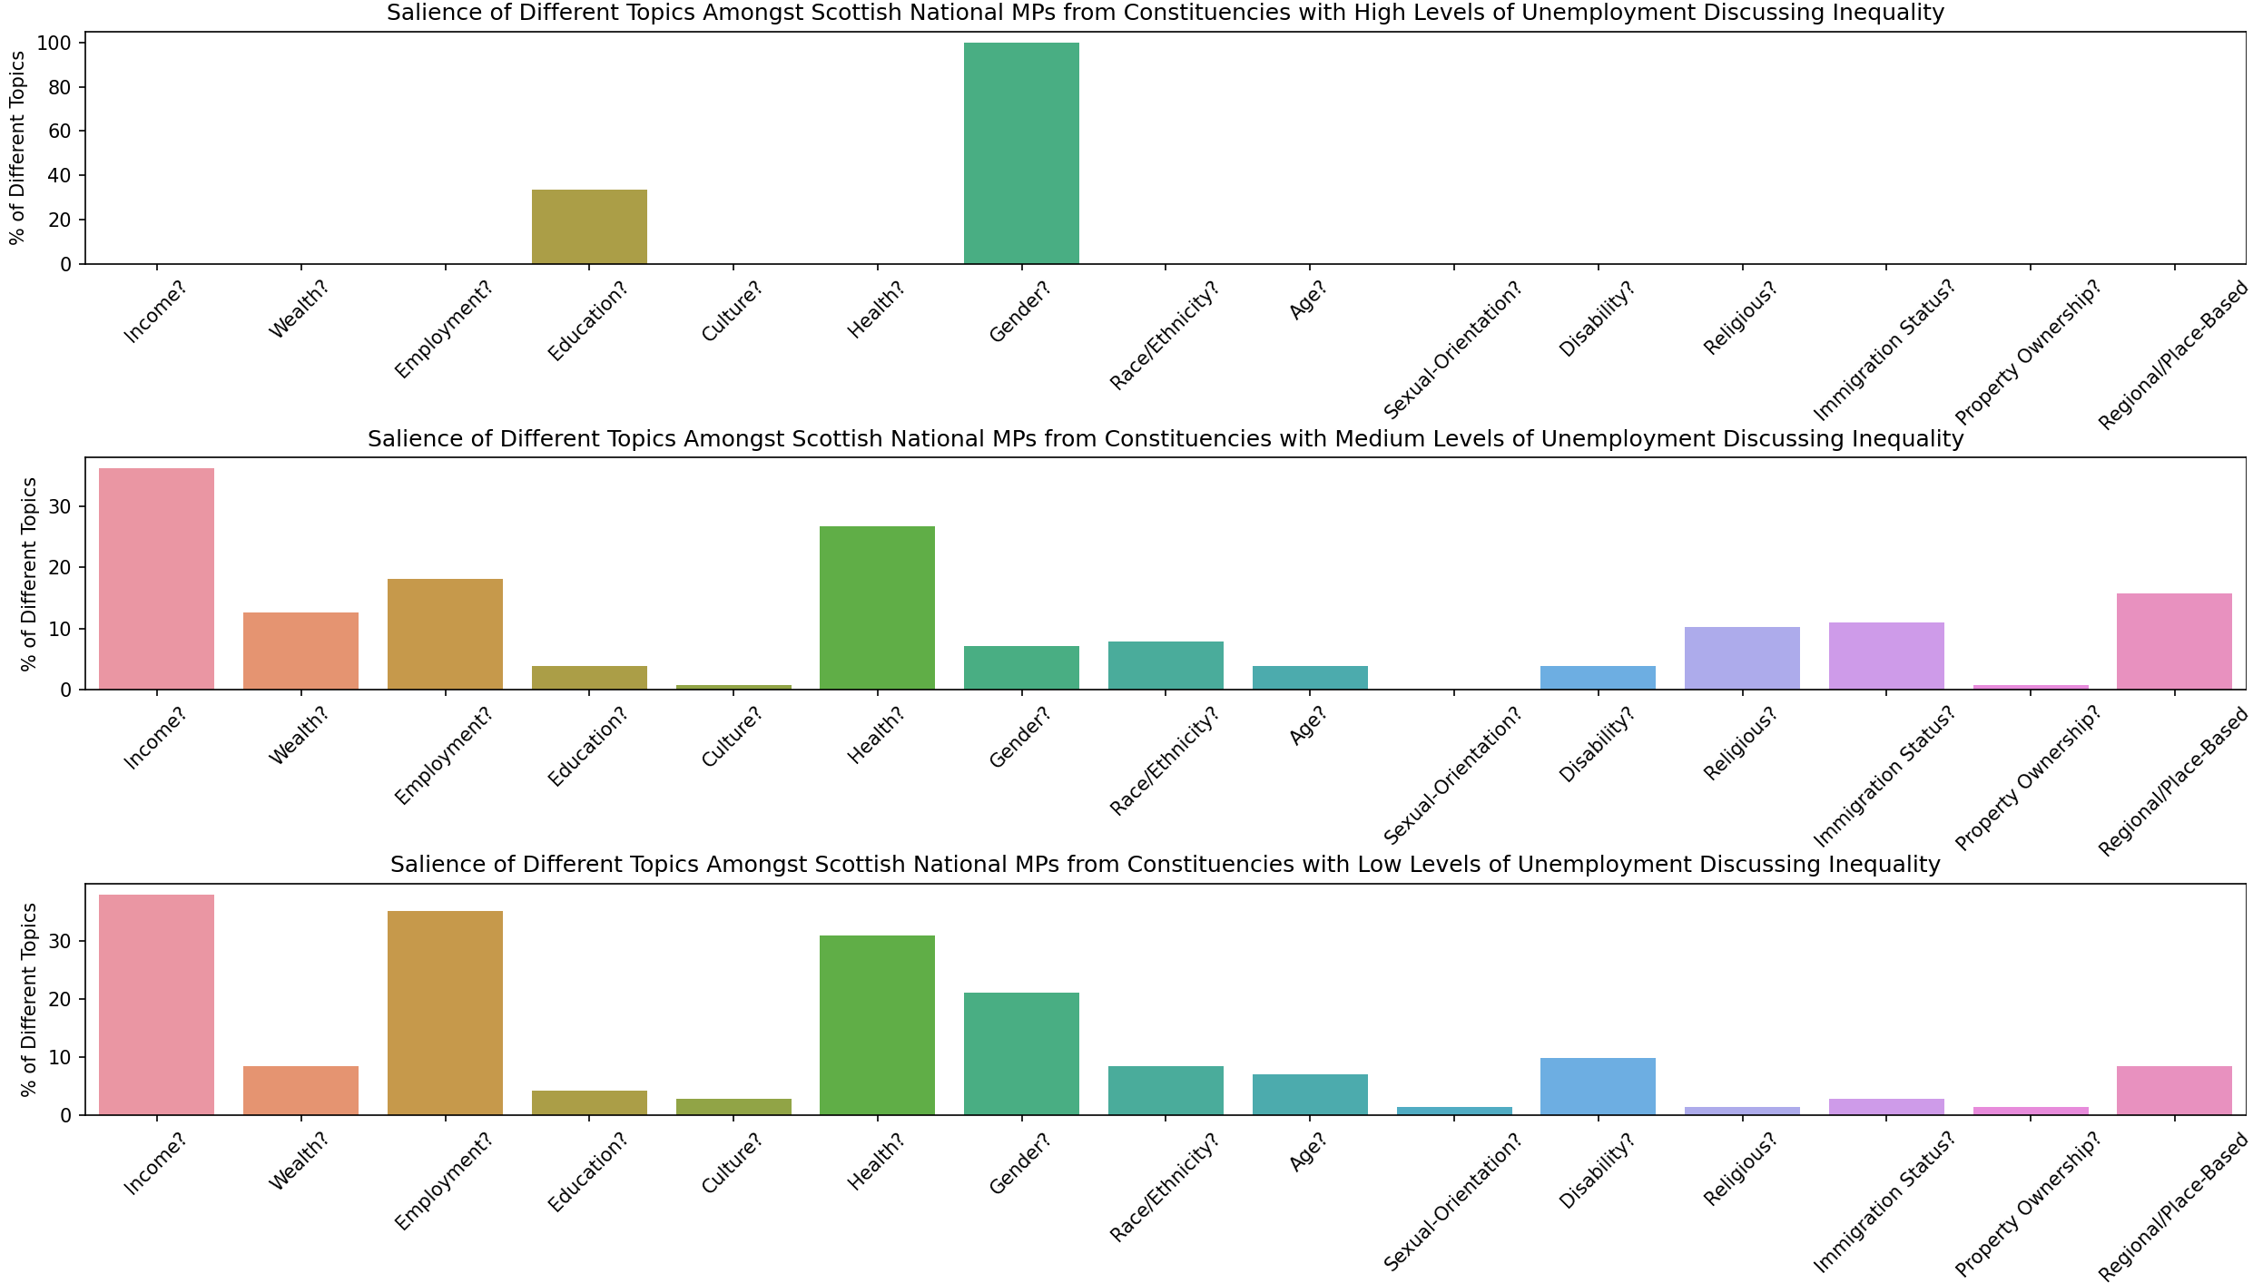

Slide 18
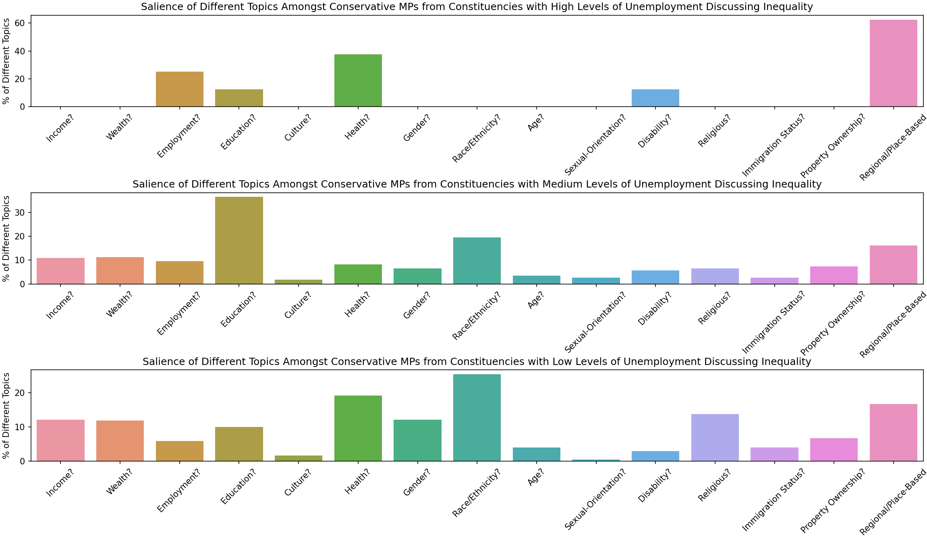

Slide 19
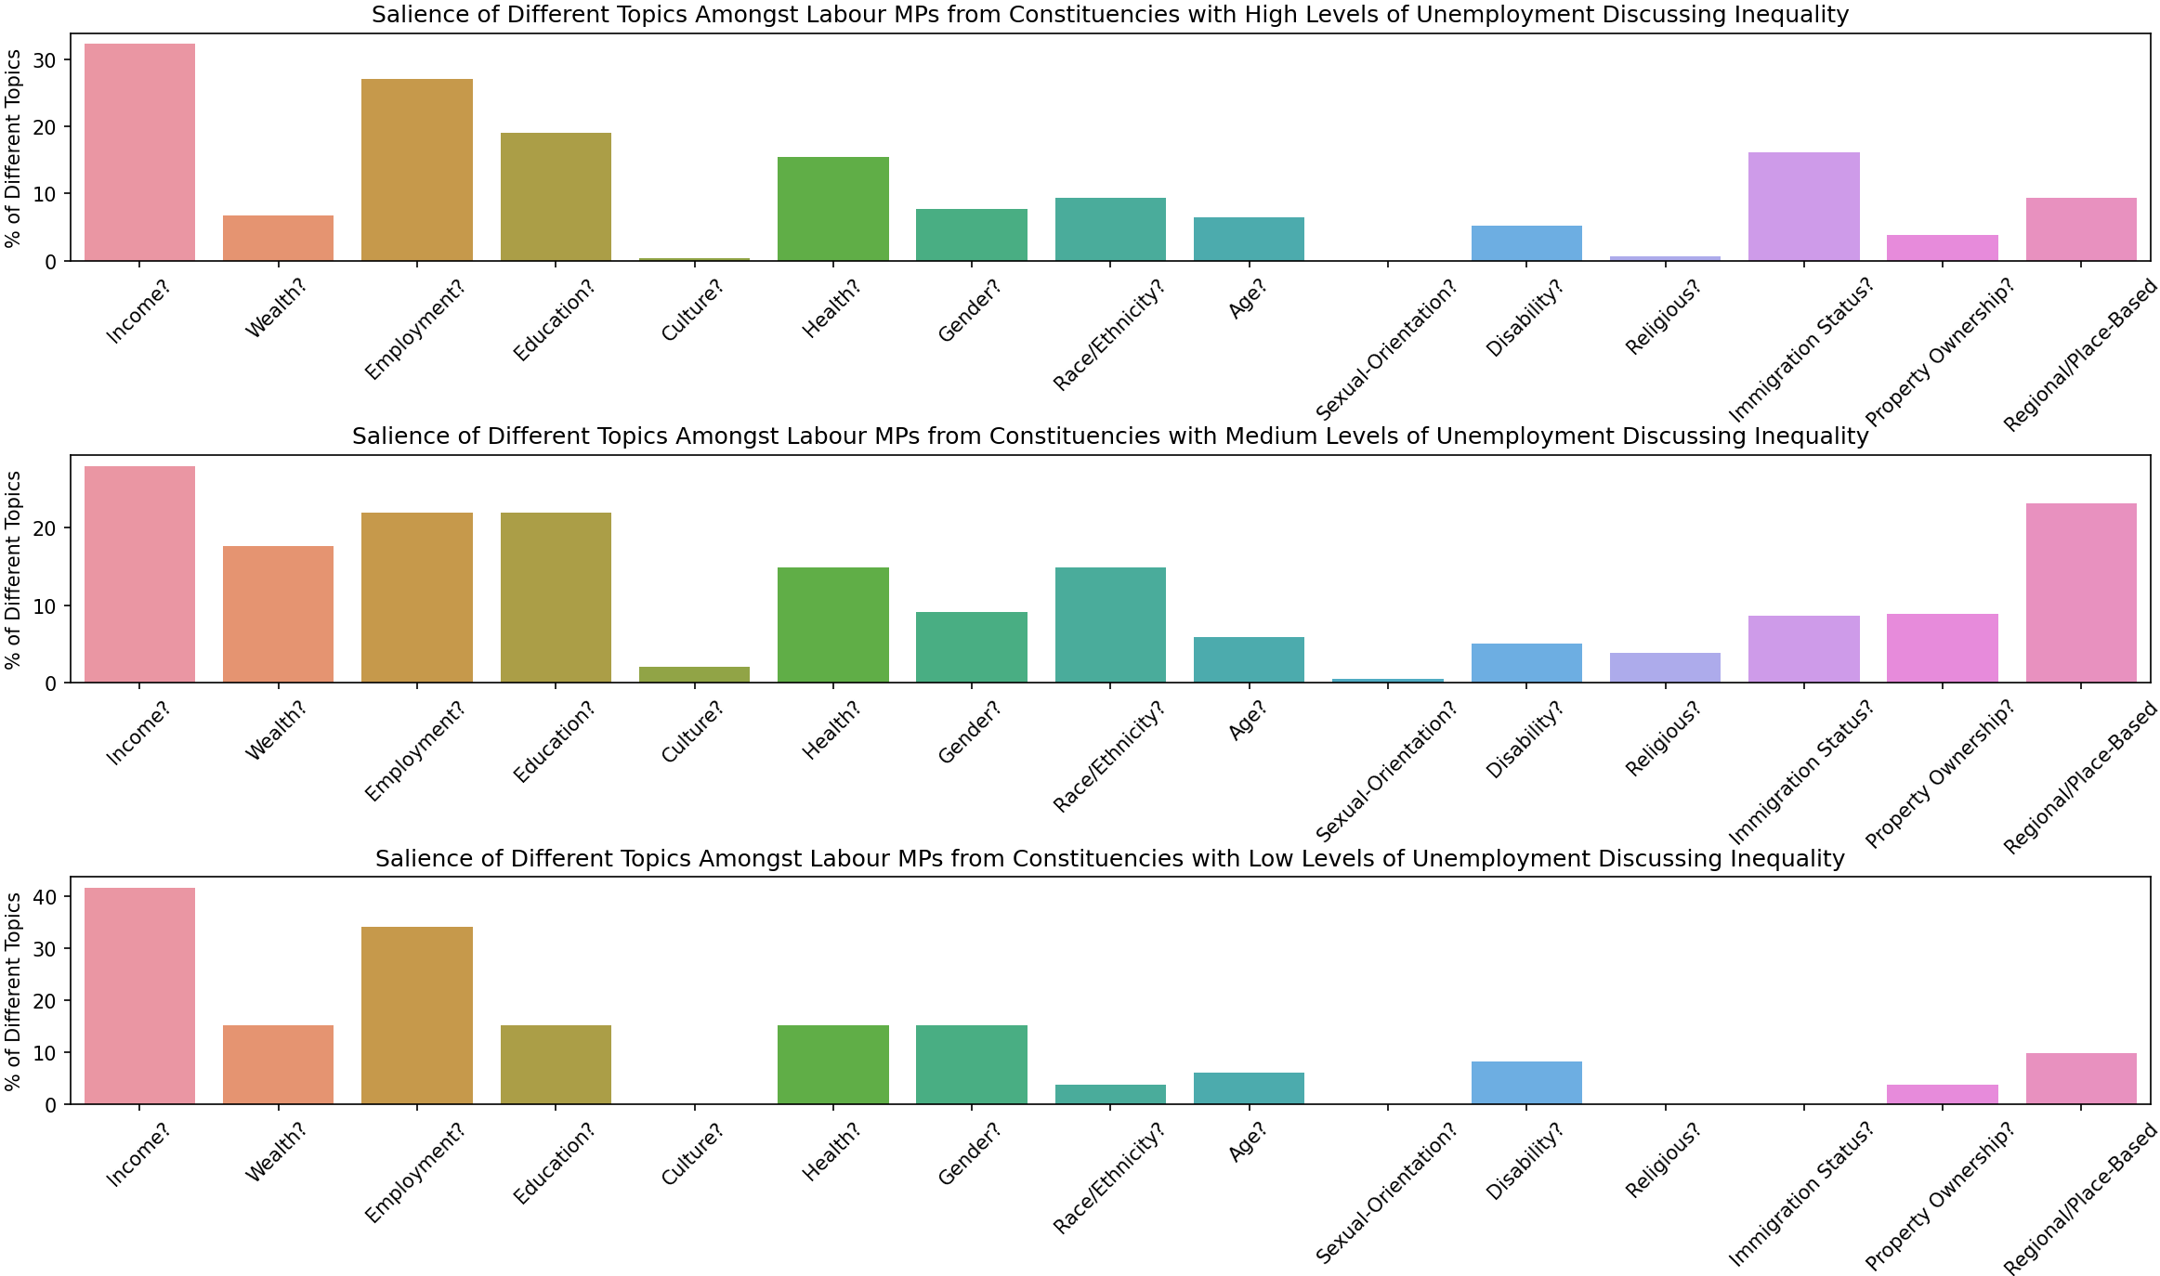

Slide 20
Conclusion/Next Steps
Offered a proof of concept for Chat-GPT as an accessible method for topic search.
This approach is very dependent upon the questions asked.
Next Steps:
  Refining prompts.
  Identifying government affiliated MPs.
  Exploring how party seniority/structure affects agenda setting.
  Exploring alternative constituency classifications for cross-section analysis.
  Expanding the analysis to other years, other types of debate, and other countries.

